Slide 1

A Smart Cities of Tomorrow: Unleashing the Power of IoT for Urban Development
Submitted in the partial fulfilment for the award of the degree of
BACHELOR OF ENGINEERING
IN
Internet Of Things
Submitted by:
Aarushi, Asmi, Saransh, Parthiv
21BCS4273, 21BCS4638, 21BCS4086, 21BCS6872
Under the Supervision of:
Mr. Mukesh Birla
Department of AIT-CSE
DISCOVER . LEARN . EMPOWER

Slide 2

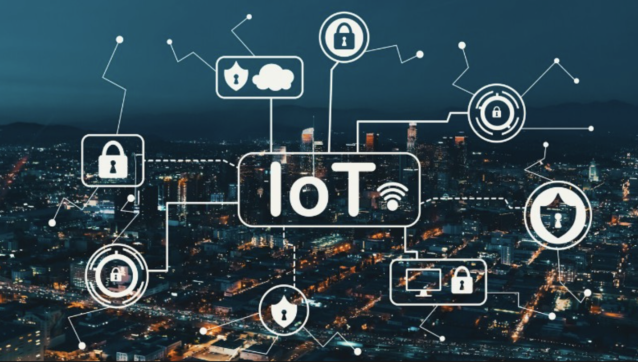
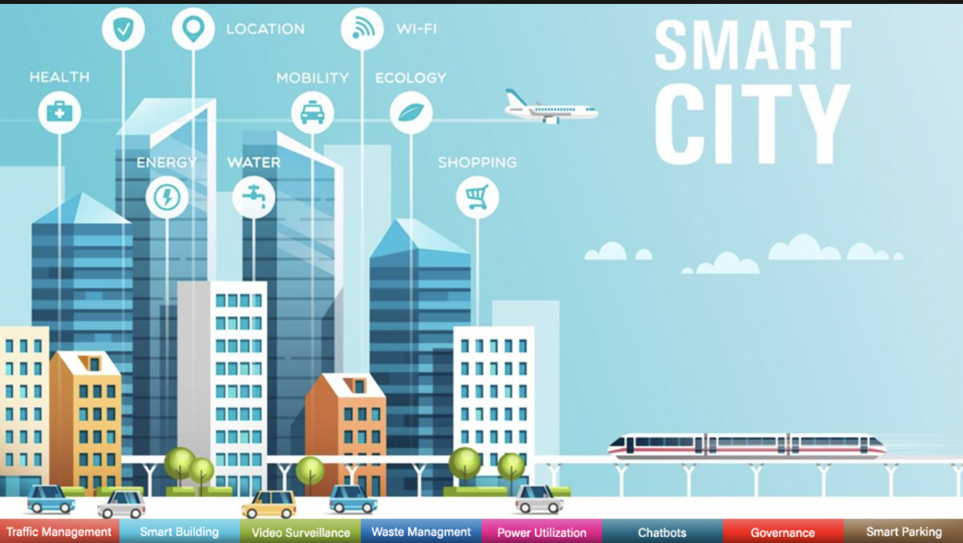
Outline
Introduction to Project
Problem Formulation
Objectives of the work
Methodology used
Results and Outputs
Conclusion
Future Scope

Slide 3
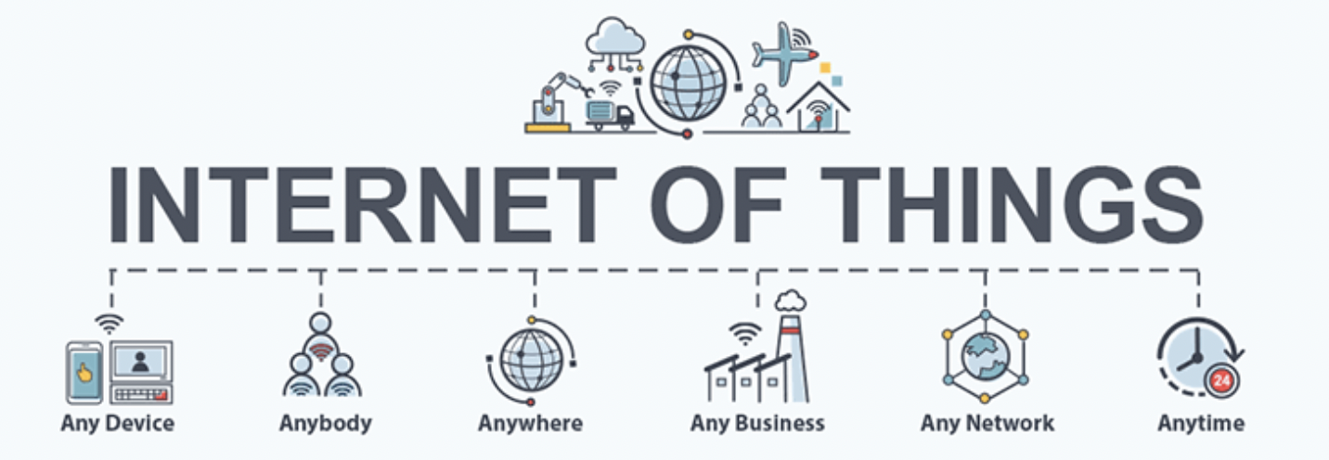
Introduction to Project
The concept of smart cities has gained significant attention in recent years as urban populations continue to grow and urbanisation trends intensify. The integration of Internet of Things (IoT) technologies into urban infrastructure offers the potential to transform cities into more efficient, sustainable, and liveable spaces. This research proposal aims to explore how IoT can be harnessed to shape the future of urban development and contribute to the creation of smarter cities. A smart city makes use of IoT, data, and technology to simplify services and make the city more connected, efficient, manageable, and cost-effective. IoT is already in vast use across the world for home security features, like online camera doors, and anti-theft protection, and many more products are available that are based on IoT.

Slide 4
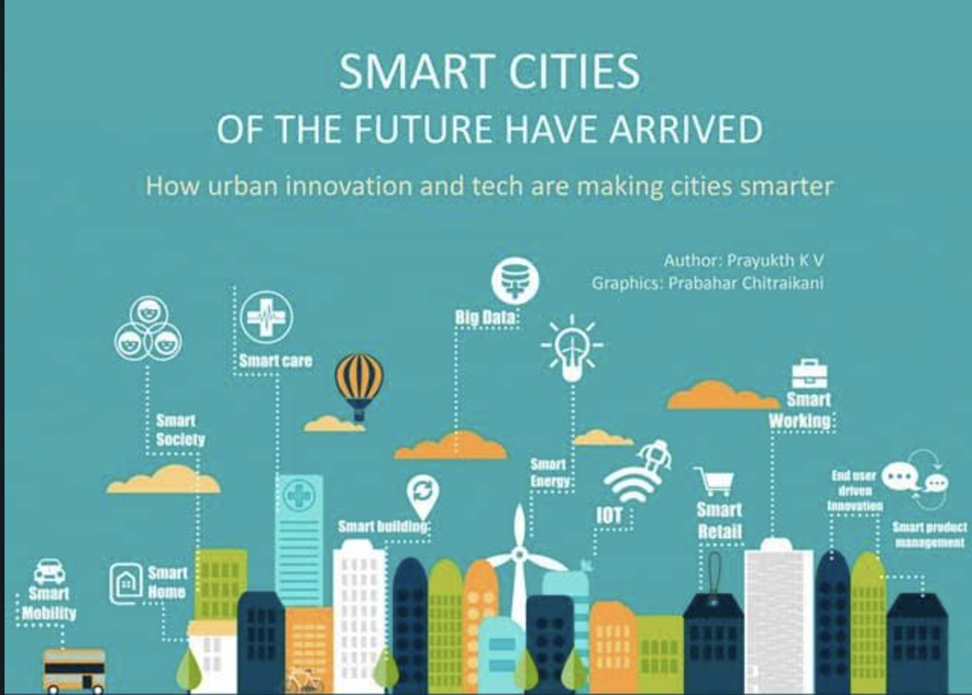
Problem Formulation
A smart city is an innovative approach to maximise the use of natural resources, improve the standard of living for its inhabitants, and also experience economic growth. However, in order for the Smart city to succeed, difficult circumstances must first be resolved. However, as we all know, there are a lot of challenges that must be overcome in order to implement IOT and make a city smart and some of them are:-
Poor connectivity apparently doubles the cost of logistics, which is unhealthy for business.
Sustainability and Environmental Impact
Urban Resilience and Disaster Management
Energy Consumption and Efficiency
These problem definitions provide a starting point for research and exploration of the challenges and complexities surrounding the integration of IoT technologies into future smart cities.

Slide 5
OBJECTIVES
To examine the current state of IoT deployment in urban environments and its impact on enhancing urban services and infrastructure.
To analyse the key challenges and opportunities associated with implementing IoT technologies for urban development.
To investigate case studies of successful smart city initiatives, focusing on the role of IoT in achieving their goals.
To propose strategies and recommendations for effectively integrating IoT into urban planning and development processes.

Slide 6
Methodology used
The study employs a multifaceted approach, starting with a comprehensive literature review to grasp IoT's current integration in urban development. Qualitative interviews capture diverse expert perspectives, while quantitative surveys gauge public attitudes towards IoT-enhanced urban features. Scrutinising operational smart city projects extracts best practices. Rigorous data analysis culminates in pragmatic recommendations for effective IoT integration in shaping the envisioned Smart Cities of Tomorrow.

Slide 7
Results and Outputs
The research paper on "A Smart Cities of Tomorrow: Unleashing the Power of IoT for Urban Development" generates pivotal outcomes:
Holistic Understanding: The study imparts comprehensive insights into IoT integration's potential and challenges in urban development.
Guided Implementation: Strategic recommendations for policymakers and planners offer practical directions for leveraging IoT effectively.
Real-world Exemplars: Analysis of existing smart city projects serves as a repository of best practices and lessons for IoT implementation.
Public Sentiment Insights: Quantitative surveys reveal public attitudes, aiding alignment of smart city initiatives with citizen preferences.
Academic and Practical Value: The paper contributes to academia while offering actionable guidance for real-world IoT deployment.
City Transformation: The research empowers cities with a roadmap for efficient resource management and elevated citizen experiences, through IoT adoption.

Slide 8
CONCLUSION
This study will examine the revolutionary potential of IoT in influencing the future of urban development, according to the research proposal. This study aims to add to the body of knowledge regarding smart city efforts and their integration with IoT technology by reviewing case studies and research articles, gaining knowledge from other scholars, and offering recommendations.
In this paper, we'll give an overview of the Internet of Things (IoT) in the context of smart cities and talk about how it can make a city smarter. We will acknowledge the drawbacks and dangers related to IoT adoption and deployment in smart cities and will work to identify viable solutions to it.

Slide 9
FUTURE SCOPE
The exploration of IoT's impact on urban development opens doors to a realm of ongoing research and implementation possibilities:
Advanced Connectivity: Further research can delve into next-generation communication technologies, enabling even more seamless interconnectivity between IoT devices in smart cities.
Data Analytics and AI: The integration of IoT-generated data with advanced analytics and artificial intelligence promises to refine urban planning, resource management, and predictive services.
Sustainability Innovations: Future studies can focus on innovative IoT-driven solutions for sustainable energy management, waste reduction, and ecological conservation in urban environments.
Smart Mobility: Exploring IoT's role in optimising transportation systems, enabling autonomous vehicles, and enhancing public transit can revolutionise urban mobility.
Citizen-Centric Design: Further research can delve into user-centric design principles to ensure IoT-driven solutions align with citizens' needs, preferences, and inclusivity.
The future scope of IoT in urban development is extensive, promising continuous advancements that reshape urban landscapes, enhance citizen experiences and address evolving challenges in the pursuit of building smarter, more sustainable cities.

Slide 10
THANK YOU

